Slide 1
GROUP 19
17 JULY 2026
BUSINESS ANALYTICS DESCRIPTIVE ANALYSIS
Amazon E-commerce Data

Slide 2
BUSINESS ANALYTICS
17 JULY 2026
AGENDA
03
METHODOLOGY
04
INTRODUCTION
05
DATA INTEGRATION & PREPROCESSING
09
EXPLORATORY ANALYSIS
17
INTERACTIVE DASHBOARD
18
CONCLUSION
Q&A
2

Slide 3
BUSINESS ANALYTICS
17 JULY 2026
METHODOLOGY
Development Environment
GOOGLE COLAB (CLOUD-BASED PYTHON NOTEBOOK)
GOOGLE DRIVE INTEGRATION FOR DATA STORAGE & ACCESS
Python Data Analysis
PANDAS (DATA LOADING, CLEANING, MERGING & AGGREGATION)
NumPy (Numerical operations & category mapping)
Matplotlib & Seaborn (Statistical analysis and visualizations)
Interactive Dashboard
HTML, CSS & JAVASCRIPT
Chart.js for interactive charts and KPIs
IPython.display for rendering dashboard components
3

Slide 4
BUSINESS ANALYTICS
17 JULY 2026
INTRODUCTION - DATASET
Open e-commerce 1.0: Five years of crowdsourced U.S. Amazon purchase histories with user demographics¹
amazon-purchases.csv
survey.csv
ORDER, SALES INFORMATION
CATEGORIES
DEMOGRAPHIC DATA
CONSUMER LEVEL VARIABLES
4
¹Berke, A., Calacci, D., Mahari, R., Yabe, T., Larson, K., Pentland, S., 2023. Open e-commerce 1.0: Five years of crowdsourced U.S. Amazon purchase histories with user demographics. https://doi.org/10.7910/DVN/YGLYDY

Slide 5
BUSINESS ANALYTICS
17 JULY 2026
BUSINESS PROBLEM
How do demographic factors define the highest-value customers
Which geographic locations (US state level) drive customer value the most
Which top-selling products can be identified
5

Slide 6


BUSINESS ANALYTICS
17 JULY 2026
DATA INTEGRATION AND PREPROCESSING
amazon-purchases.csv
Survey ResponseID
survey.csv
Data Integration
Data Reduction
Data Cleaning
Data Transformation
6

Slide 7
BUSINESS ANALYTICS
17 JULY 2026
PRELIMINARY ANALYSIS
1,761,259 Rows
9 Category Datapoints
6 Numerical Datapoints
Time Range: Jan. 01 2018 - Aug. 15 2024
Total Revenue: $41,730,373
Avg. Order Value: $24
7

Slide 8
BUSINESS ANALYTICS
17 JULY 2026
PRELIMINARY ANALYSIS
Category | (US) State | (Product) Category | Agg_Category | Age | Gender | Income | Education
Unique | 52 | 1871 | 21 | 6 | 4 | 7 | 5
Top | California | ABIS_BOOK | Other / Misc | 25 - 34 years | Female | $100,000 - $149,999 | Bachelor’s degree
8

Slide 9
BUSINESS ANALYTICS
17 JULY 2026
EXPLORATORY DATA ANALYSIS
TOTAL PRICE DISTRIBUTION
OUTLIERS
CATEGORIES BY PURCHASE COUNT
DEMOGRAPHIC PATTERNS
REVENUE BY INCOME GROUP
REVENUE BY AGE GROUP
REVENUE BY STATE
TIME PATTERNS
MONTHLY TREND
DAYS IN WEEK PATTERN
9

Slide 10
BUSINESS ANALYTICS
17 JULY 2026
HOW OUR METRICS WORK
Total Price is calculated per row, as unit price times quantity, computed once per purchased item.
Total Revenue is a single sum for the entire dataset across all 1.76 million rows.
The histogram shows the spread of individual purchase values, not the single total revenue figure.
For the demographic and geographic charts, we just group those same purchase amounts by the buyer's income, age, or state label that came from the survey, and sum within each group.
All our revenue and count metrics are computed from the Amazon purchase transaction data: Total Price, categories, dates.
The survey supplies the demographic labels we use to slice and group those purchases.
10

Slide 11
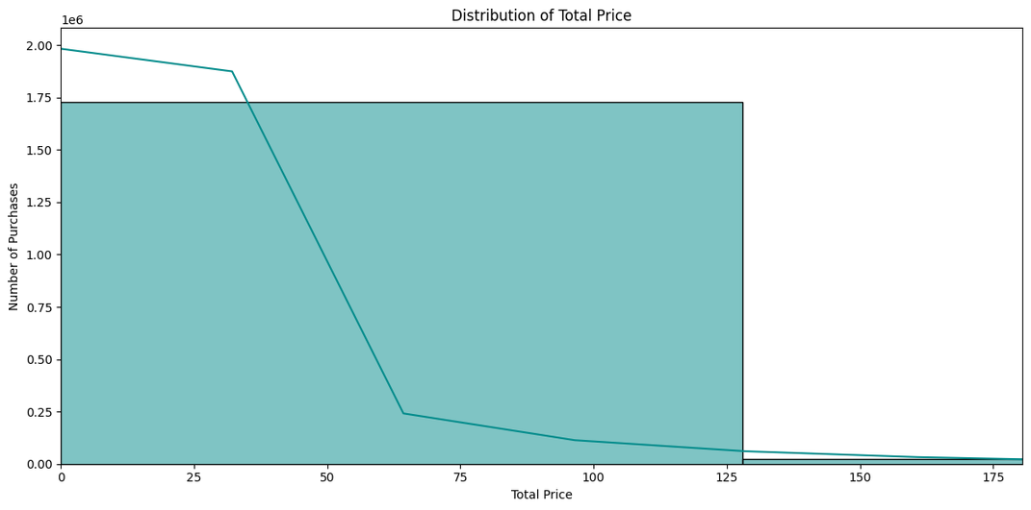
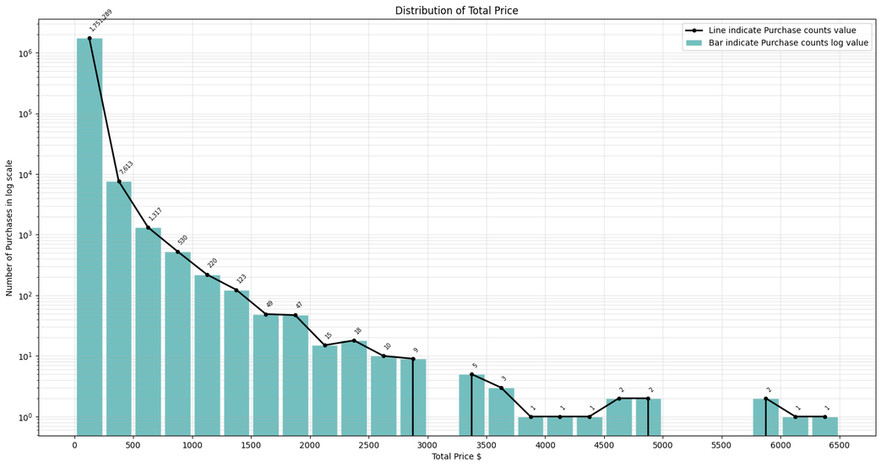
BUSINESS ANALYTICS
17 JULY 2026
TOTAL PRICE DISTRIBUTION
SHAPE OF PURCHASE VALUES (TOTAL PRICE)
YOUR PARAGRAPH TEXT
Total Revenue ≈ $41.7M
Median purchase value: $14.49 ; Mean: $23.69 ; 75th Percentile: $24.84
Maximum single line item: $6,398.95
Few very expensive purchases create a long right tail; Most transactions are low value, with revenue highly skewed.
11

Slide 12
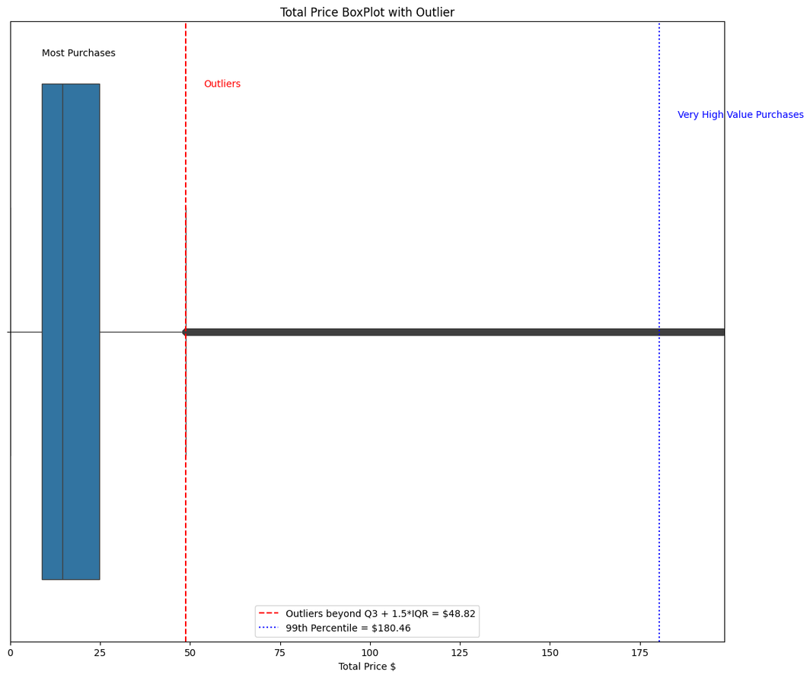
BUSINESS ANALYTICS
17 JULY 2026
OUTLIERS
Right-Skewed Distribution: A few large ones pull the mean to the right
There are many small values and few large ones
Outliers: Purchases more than $48.82 (Q3 + 1.5 * IQR) are outliers, significantly different from the majority
12

Slide 13
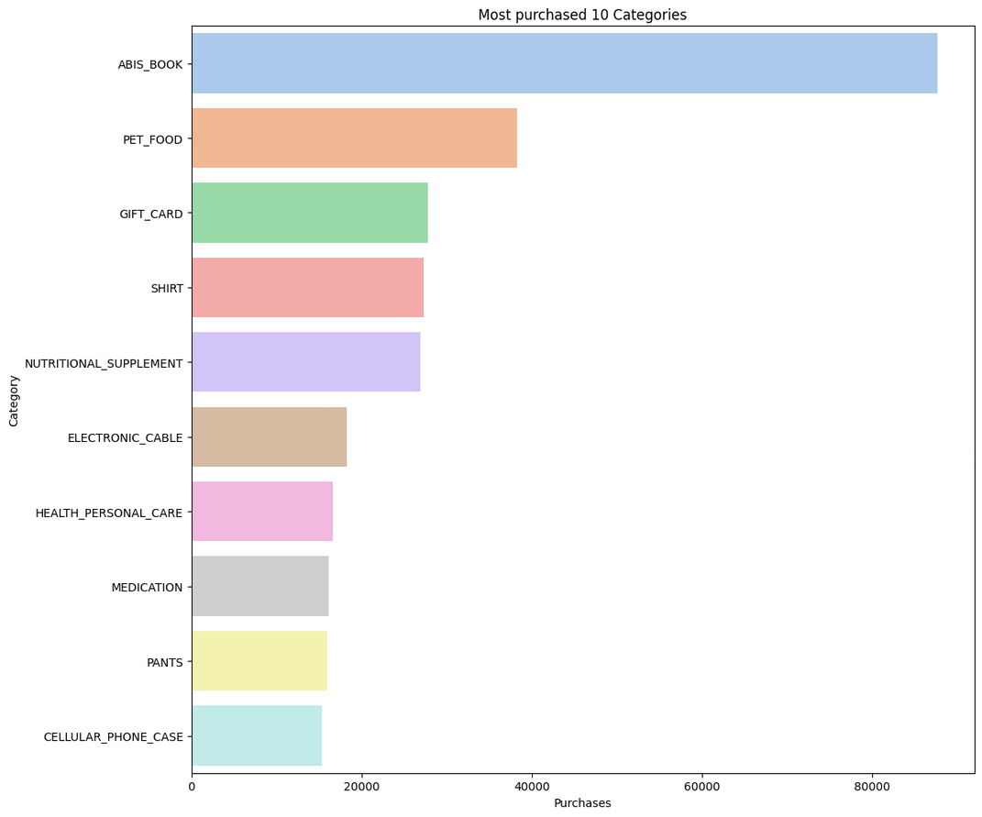
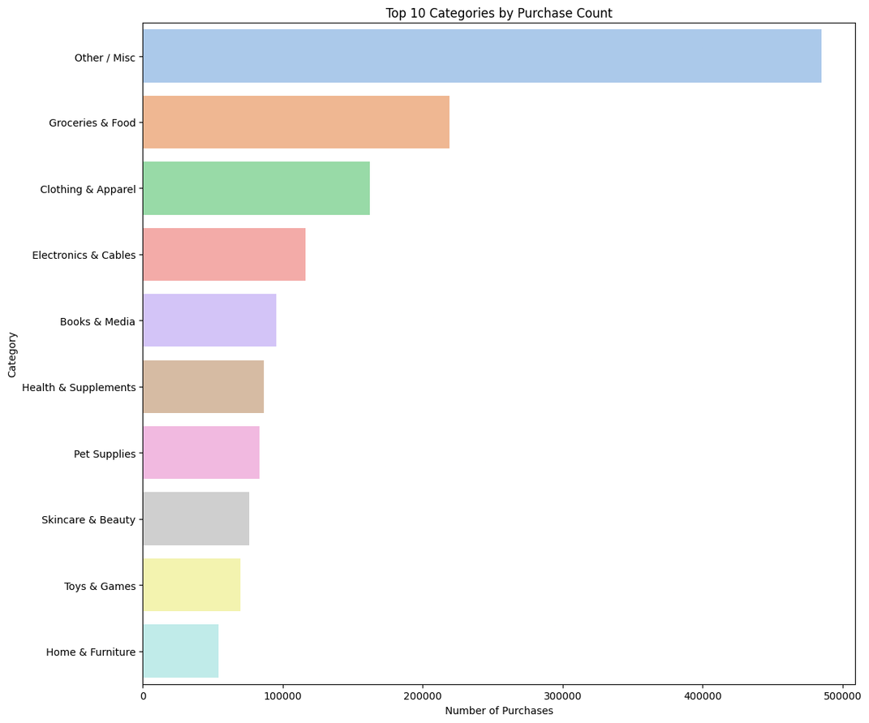
BUSINESS ANALYTICS
17 JULY 2026
TOP CATEGORIES (BY PURCHASES)
Default Categories
Aggregated Categories
Top raw category: abis_book with 87,619 purchases
Others: pet_food, gift_card, shirt
Top aggregate families: groceries & food with 219,287 purchases
Top categories in Other / Misc with purchases:
electronic_cable -18268, physical_movie -6920, shorts -6274
13

Slide 14
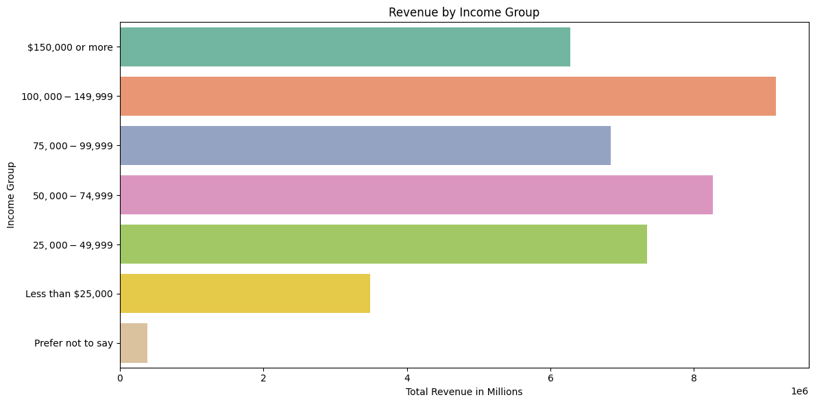
BUSINESS ANALYTICS
17 JULY 2026
REVENUE BY INCOME GROUP
$100,000 to $149,999 income group generates the highest total revenue: $9.14M
Next highest groups: $50k–$74,999 ($8.26M) and $25k–$49,999 ($7.34M)
Very-high-income group ($150k+) contributes less total revenue than the upper middle income group
14

Slide 15
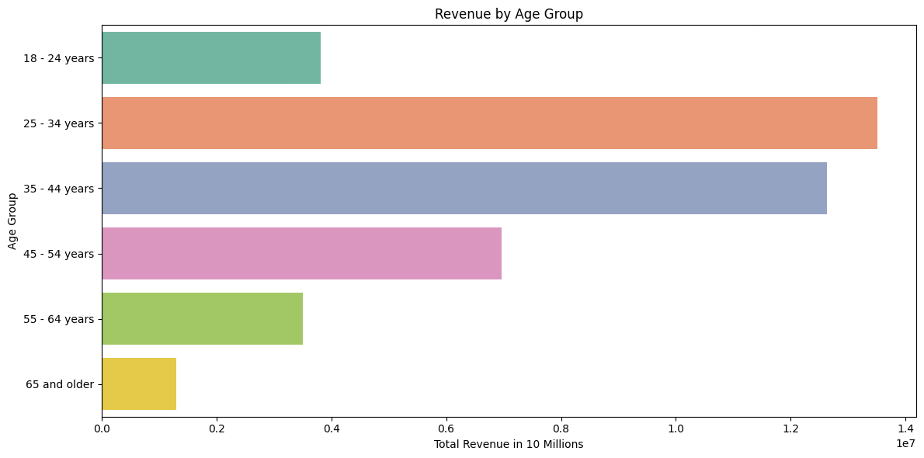
BUSINESS ANALYTICS
17 JULY 2026
REVENUE BY AGE GROUP
Largest age segment by revenue: 25-34 years with total revenue ≈ $13 Million
Top two age groups 25–34 and 35–44 together account for most spending and most transactions
Older and younger groups spend less overall, consistent with fewer purchases
15

Slide 16
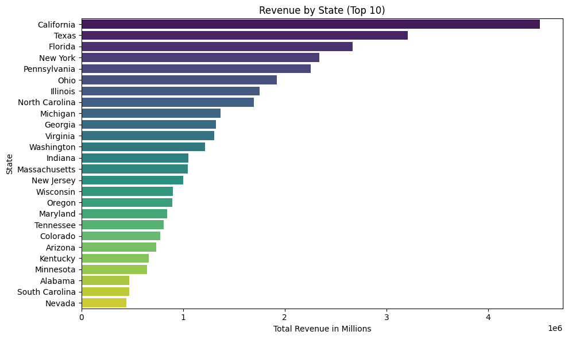
BUSINESS ANALYTICS
17 JULY 2026
REVENUE BY STATE (TOP 10)
16
California leads with $4.11M in revenue
Texas ($3.08M) and Florida ($2.53M) follow; top 5 states (CA, TX, FL, NY, PA) together exceed $14M

Slide 17
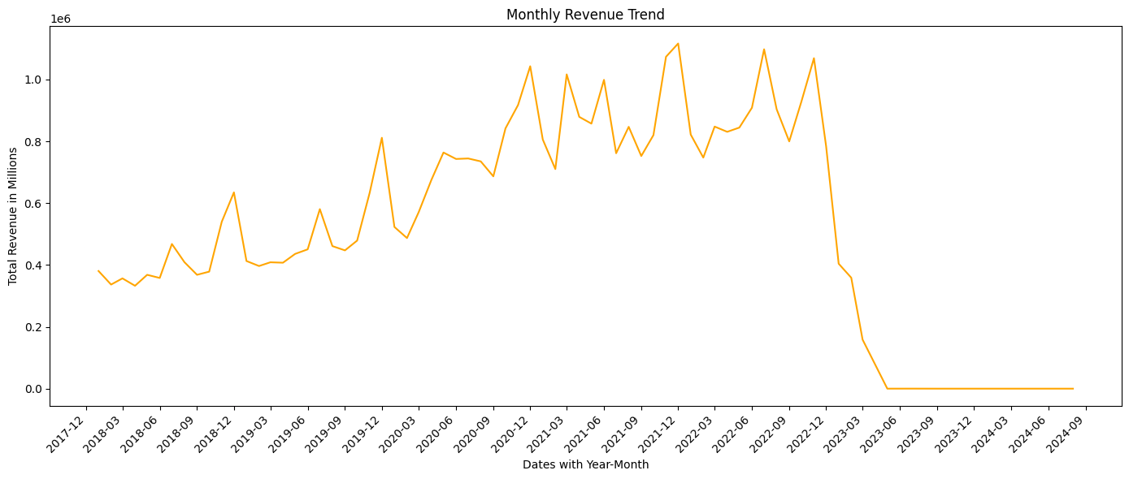
BUSINESS ANALYTICS
17 JULY 2026
TIME PATTERNS (MONTHLY TREND)
Data spans from Jan 2018 to Aug 2024
Overall monthly revenue grows until around 2022, then shows a decline around 2023
Seasonal peaks likely around typical shopping seasons (end-of-year, mid-year promotions)
17

Slide 18
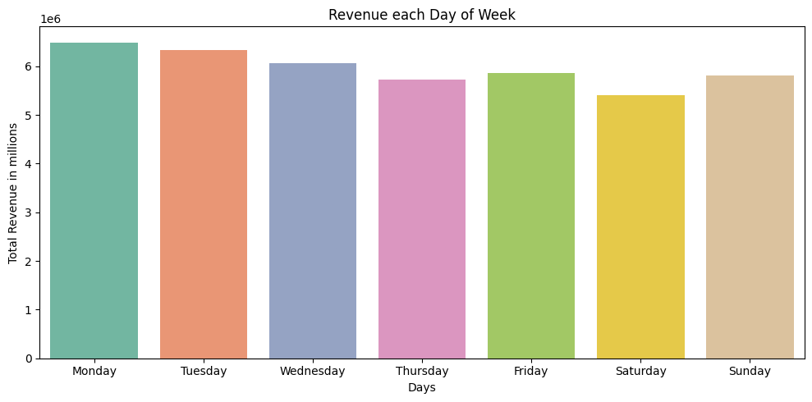
BUSINESS ANALYTICS
17 JULY 2026
TIME PATTERNS (DAY OF WEEK)
Highest revenue day: Mondays $6 million with consistent weekly demand peak.
Lowest revenue day: saturday with off-peak buying period
Useful for scheduling campaigns and staffing ; aim promotions at high-revenue days
18

Slide 19
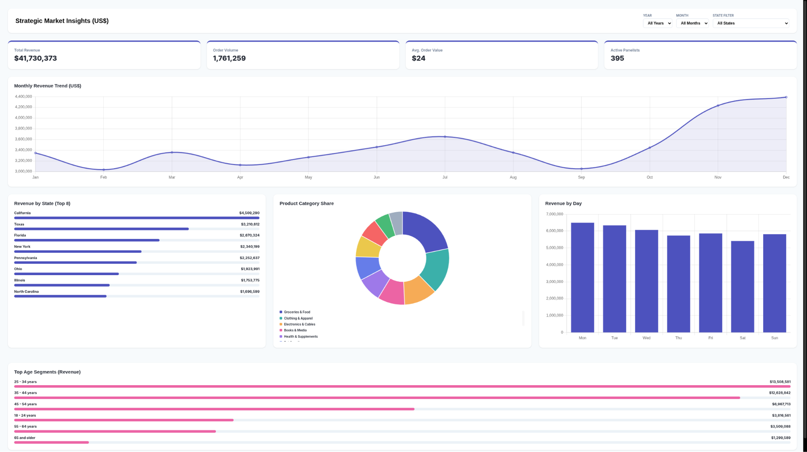
BUSINESS ANALYTICS
17 JULY 2026
INTERACTIVE DASHBOARD
19

Slide 20
BUSINESS ANALYTICS
17 JULY 2026
CONCLUSION - BUSINESS INSIGHTS
Revenue is highly concentrated: many purchases are low value, while a small number of orders contribute disproportionately to total revenue.
Product demand is not evenly spread across categories: groceries and food stand out strongly in the aggregated view, while books are highly visible in the detailed labels.
High-value customers are associated with specific demographic segments, especially the income bracket around $100,000–$149,999 and the age group 25–34.
Geographic demand differs across states, with California appearing as the strongest contributor in the current dataset.
20

Slide 21
BUSINESS ANALYTICS
17 JULY 2026
QUESTIONS?
21

